Slide 1
Devops Boot camp Batch 2 – Group 7
Case Study – MARSLANDER Telecom Services
11/Apr/2020
Contributed and Presented By-
  Asimansu Bera
  Adnan Press Wala
  Aditya kharwade
  Narendar Ega
  Adarsh Kumar Singh

Slide 2
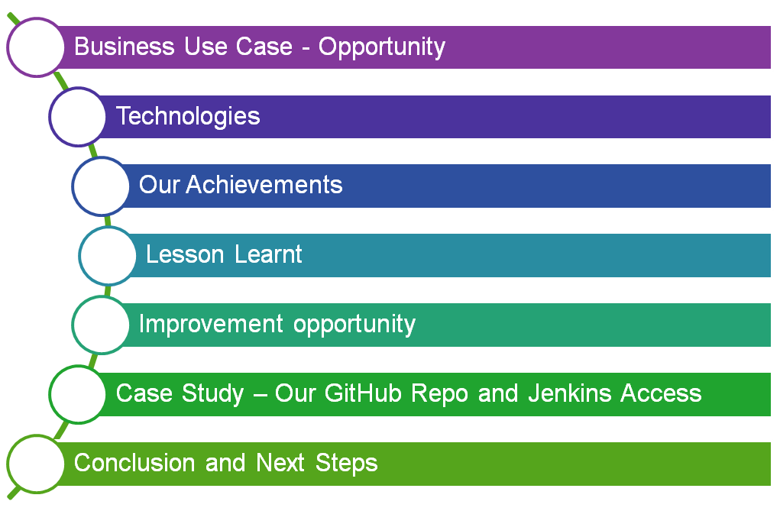
Agenda
TCS Internal

Slide 3

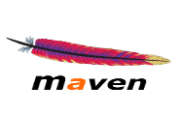
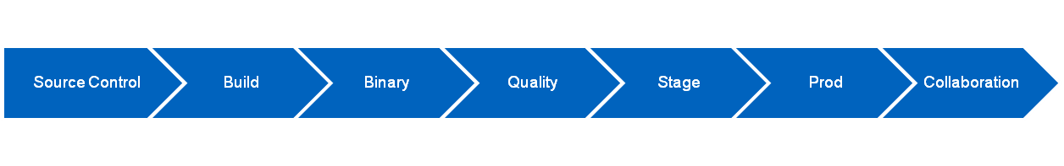
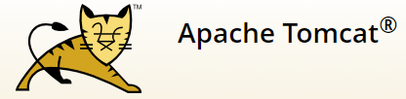






Business Use Case - Opportunity
Business Objectives
Marslander as part of their DevOps transformation journey is strategically transforming one of their program -Phoenix into DevOps Model. The main driver for this transformation is a need to improve time-to-market for new application functionality or other code changes.
Our Technology Solution
Continuous Integration
Continuous Delivery
Determine - Continuous Delivery and DevOps are right solution to achieve the objectives
Create the Pipeline through Jenkins Pipeline -Use Blue Ocean Pipeline view.
Set up Sonarqube,Artifactory, & Jira and Integrate GitHub & Jira with Slack
TCS Internal

Slide 4
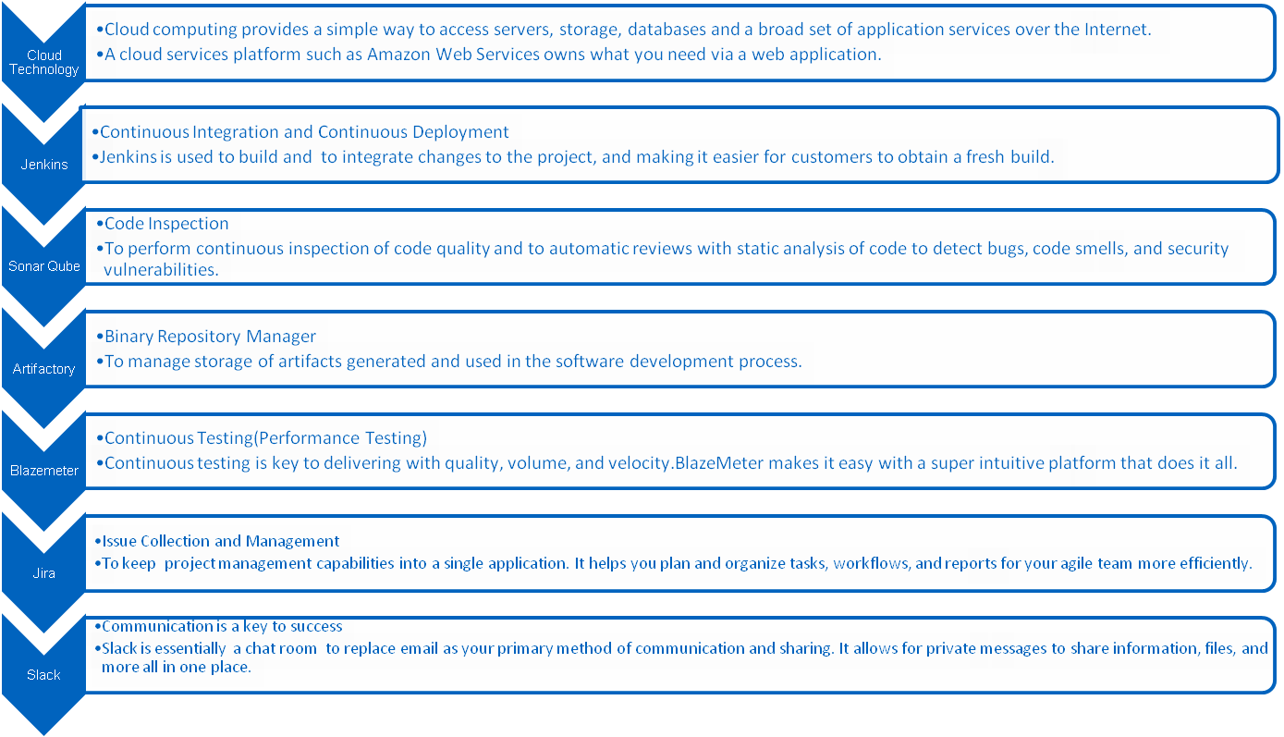
Technologies
TCS Internal

Slide 5

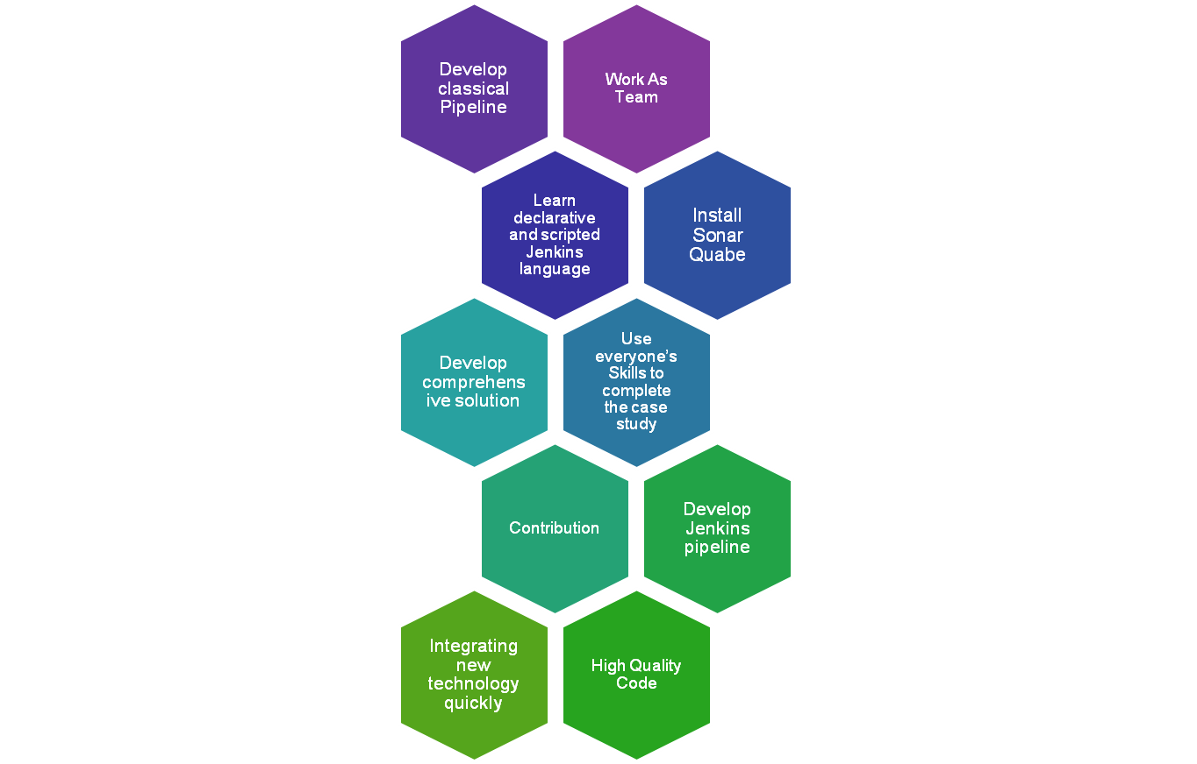
Our Achievements
TCS Internal

Slide 6
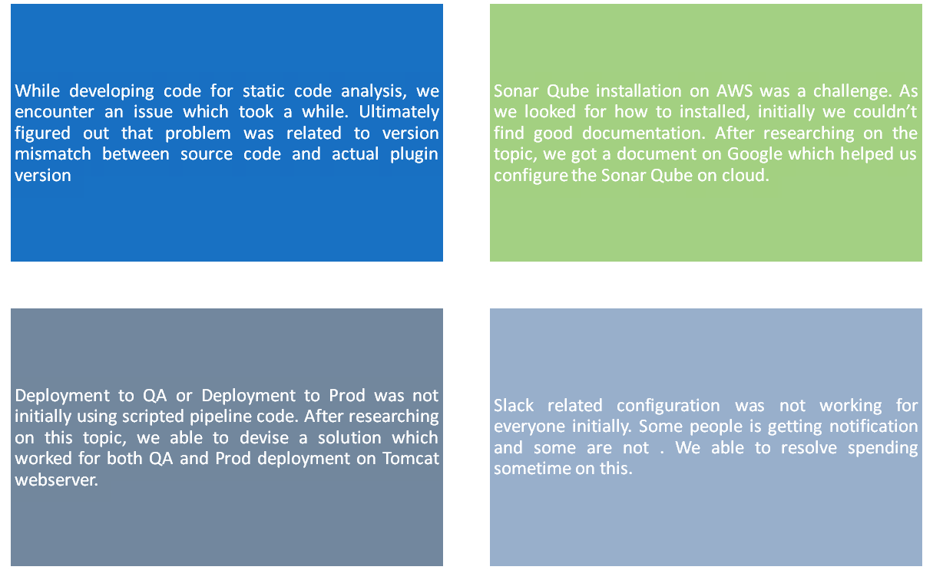
Lesson Learnt
TCS Internal

Slide 7
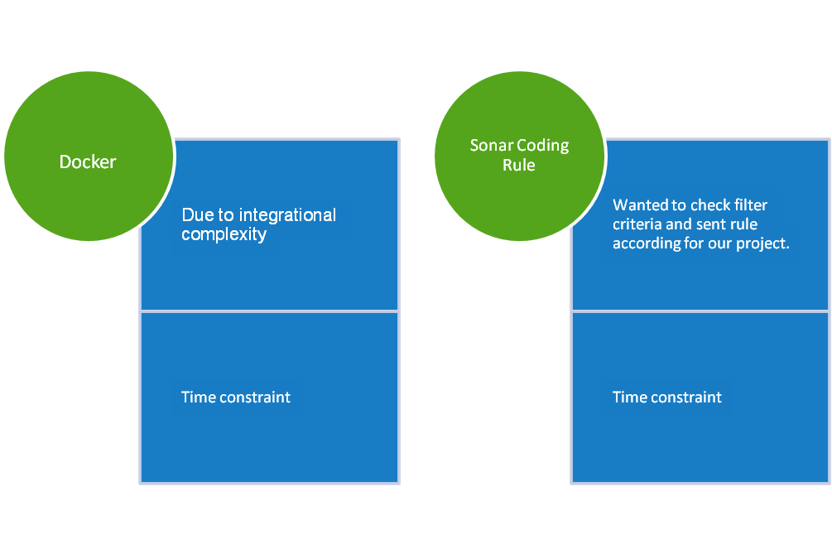
Improvement Opportunity
TCS Internal

Slide 8
Case Study – Our GitHub Repo and Jenkins Access
Below links and Jenkins are accessible to review our Case study and project
Details | Link | Remarks
GitHub Repo | https://github.com/anushanari1010/g7webapp.git | Repo is updated with all latest source code used four our project
Jenkinsfile | https://github.com/anushanari1010/g7webapp/blob/master/Jenkinsfile | Jenkinsfile contains scripted source code for the pipeline
Jenkins | http://104.42.151.104:8080/job/G7-Pipeline-Through-Code/ | Jenkins has Jenkins/Jenkins to access our code to pipeline job to run and watch using Blue Ocean
TCS Internal

Slide 9
Conclusion and Next Steps
Conclusion
Started Devops learning starting prerequisites to complete and get into the training program
Spending quite a lot different unknown technologies – Jenkins, Balzement, Sonar Qube, Docker, Blazemeter , Slack etc
Two days 9-6 training – full day schedule
Completing this case study
Hopefully, we will able to get our certificate as Devops certified professional
Investment in education is best investment – Bill Gates
Thanks to Derivyan Sir and Anubha Mam for continuous encouragement
Next Steps
Learnt what is meant by CI/CD and technology helps to realizing the concept
Hoping to use and exploit this experience in our career by actively looking for DevOps project
Look for opportunity to extend this skills to learn cloud based Devops being used in Azure Devops, AWS Devops, GCP DevOps
TCS Internal

